Slide 1

Introduction to Visual Studio for Mac for .NET development
Nithin Mohan
@nithinmohantk
Systems Dev,
Pramerica

Slide 2





Overview
Introduction
Quick retrospective
See it in action
Learn what’s new
Preview what’s coming

Slide 3
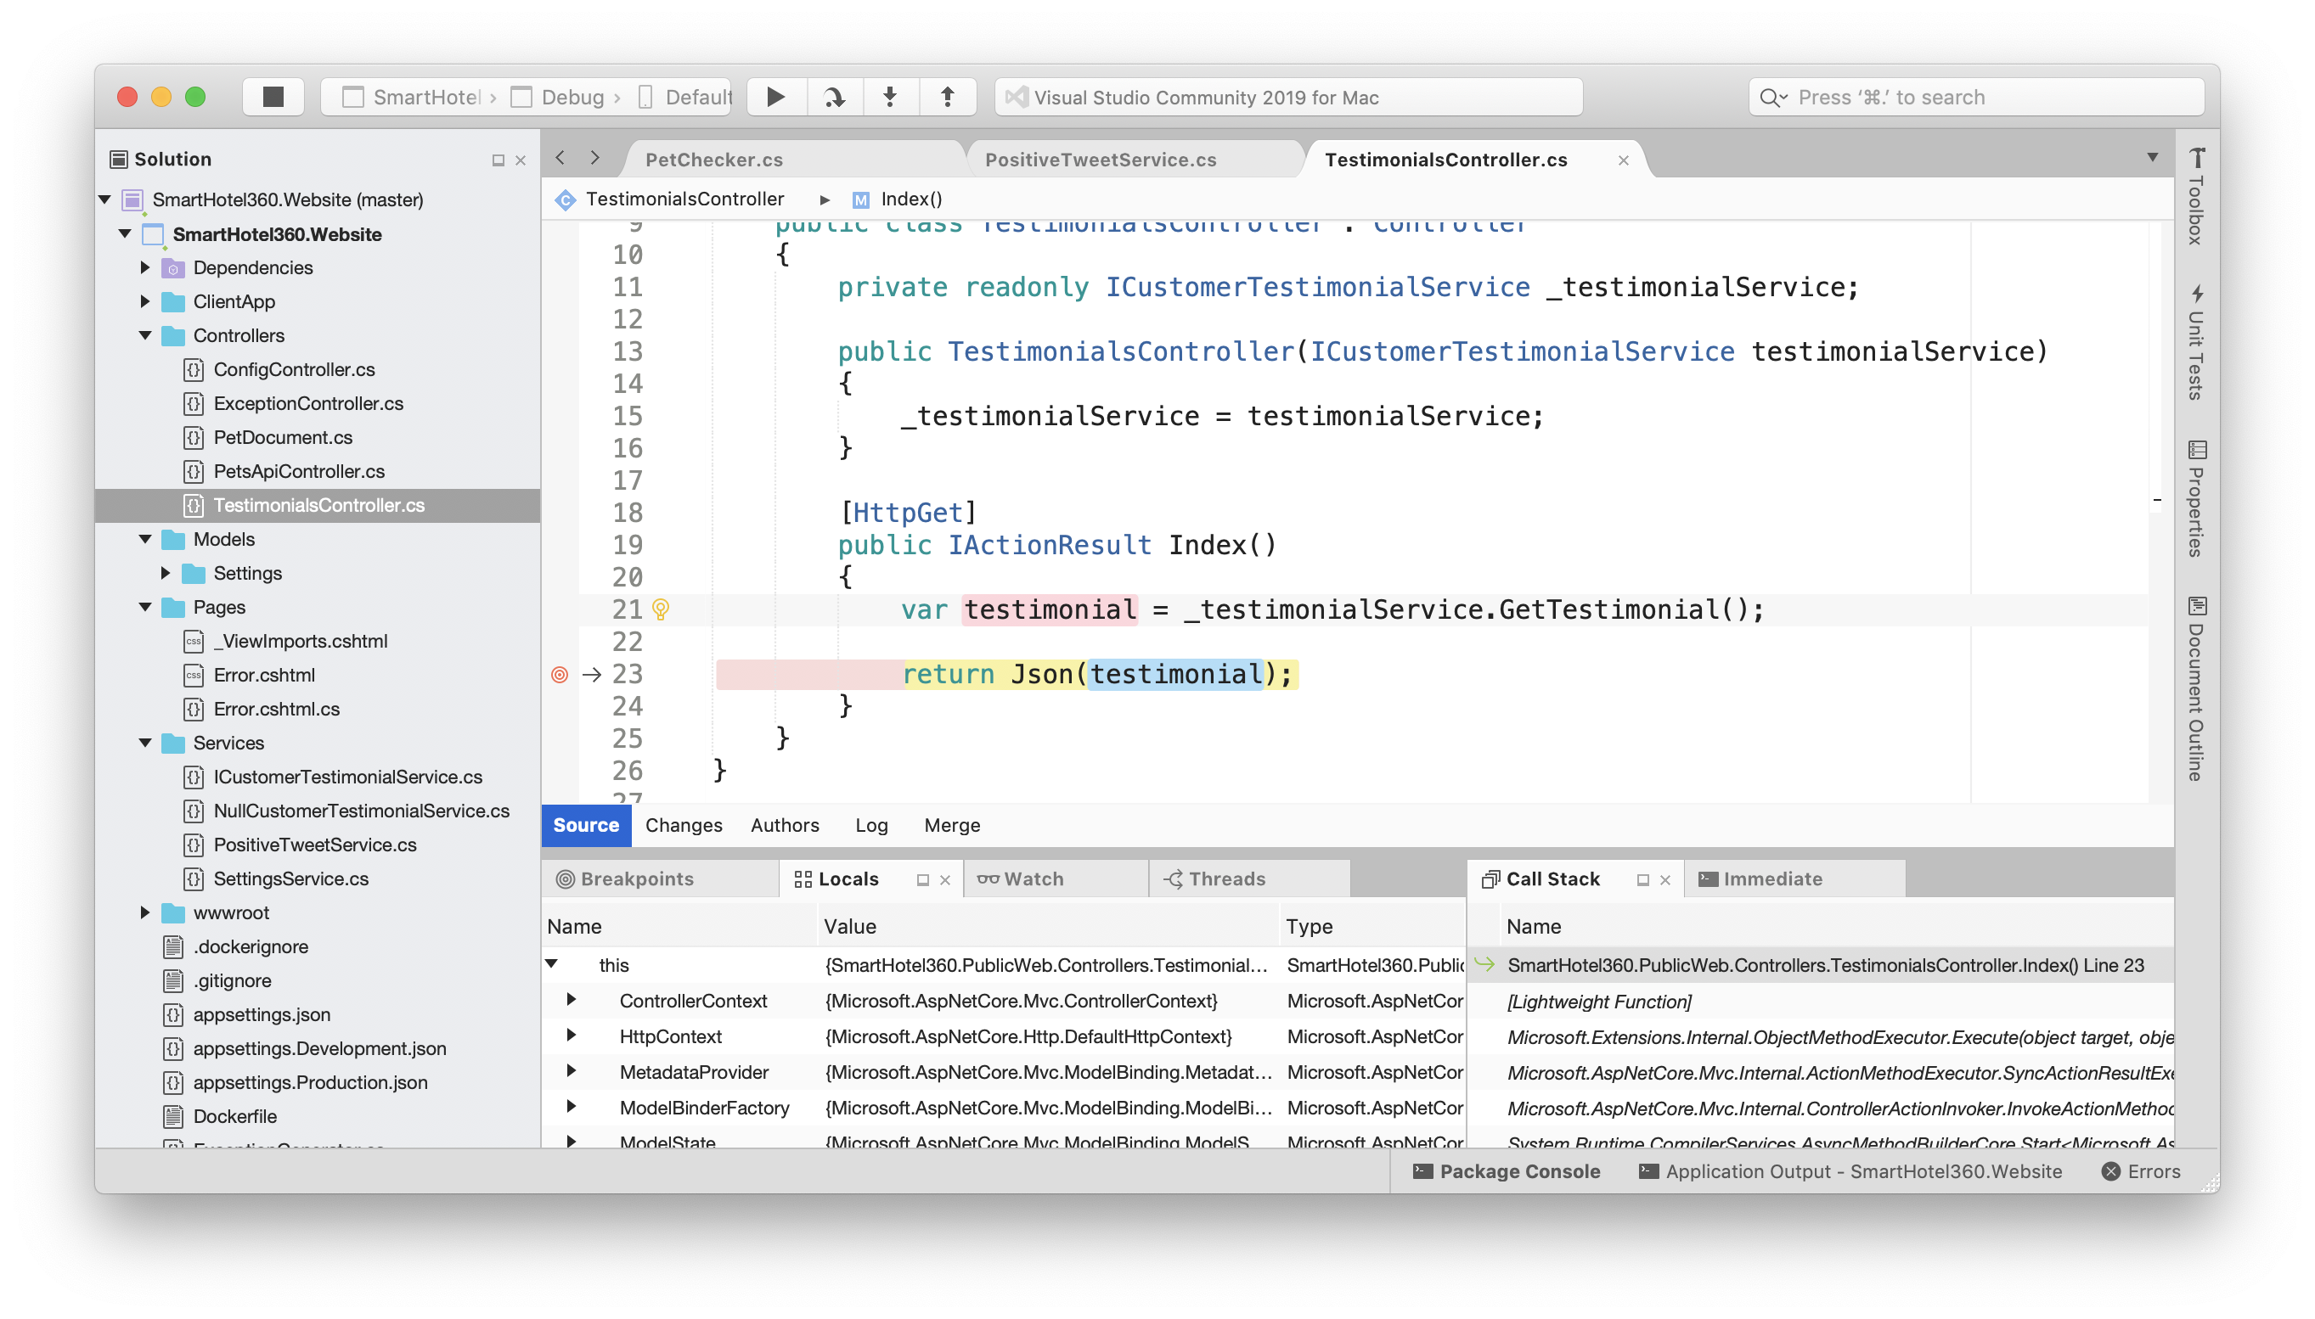
Meet Visual Studio for Mac
.NET IDE for the Mac
Native experience
Develop apps and games
for iOS, Android and web

Slide 4

Visual Studio for Mac
Roslyn
MSBuild
NuGet
VS Platform
.NET

Slide 5
Xamarin
ASP.NET Core
Docker
Azure Functions
Unity
.NET Core
Visual Studio for Mac

Slide 6
Visual Studio for Mac

Slide 7
Jun 2017
7.0
Visual Studio 2017 for Mac

Slide 8
Jun 2017
7.0
Xamarin, .NET Core and Unity
Rich C# editing and debugging
Web editors

Slide 9
Aug 2017
7.1
7.0
.NET Core 2.0 support
Improved iOS app signing
Integrated Android SDK manager

Slide 10
Oct 2017
7.2
7.0
7.1
Docker publishing
Xcode 9 & Android 8.0
On-demand Android SDK

Slide 11
Dec 2017
7.3
7.0
7.1
7.2
Automatic iOS signing
Visual Studio Test Platform integration
Updater for Android SDK and .NET Core
iOS designer constraints mode

Slide 12
Mar 2018
7.4
7.1
7.2
7.3
C# 7.1 & IntelliSense upgrades
Wireless iOS deployment and debugging
macOS High Sierra & Xcode 9.3

Slide 13
May 2018
7.5
7.2
7.3
7.4
editorconfig support
Razor, TypeScript, JavaScript IntelliSense
Major Xamarin.Forms tooling updates
C# 7.2, .NET Core 2.1
Azure Functions projects

Slide 14
Aug 2018
7.6
7.3
7.4
7.5
Azure Functions publishing
Streamlined ‘Report a Problem’

Slide 15
Nov 2018
7.7
7.4
7.5
7.6
Quick Fix lightbulbs
ASP.NET Core Publish to Folder
.NET Core 2.2, NuGet 4.7

Slide 16
Feb 2019
7.8
7.5
7.6
7.7
Performance & reliability improvements
.NET Core and NuGet updates

Slide 17
Today
8.0
7.6
7.7
7.8
Visual Studio 2019 for Mac

Slide 18
Today
8.0
7.7
7.8
Visual Studio 2019 for Mac

Slide 19
Demo

Slide 20
Powerful and Capable
C#, F#, TypeScript, Razor, CSS/LESS/SASS, HTML5
Analyzers, fixes, refactoring and code navigation
Rich debugging capabilities
xUnit, MSTest, NUnit
Git source control

Slide 21
New in 2019
Streamlined start window
Roslyn 3.0 analyzers and fixes
Performance & reliability
New Git backend and Azure DevOps authentication
Major accessibility improvements
New C# editor (preview)

Slide 22
Performance and reliability
Ongoing focus, improvements in all releases
Infrastructure to identify and track issues
Major accessibility improvements, more to come
Thank you for reporting issues through Developer Community!

Slide 23
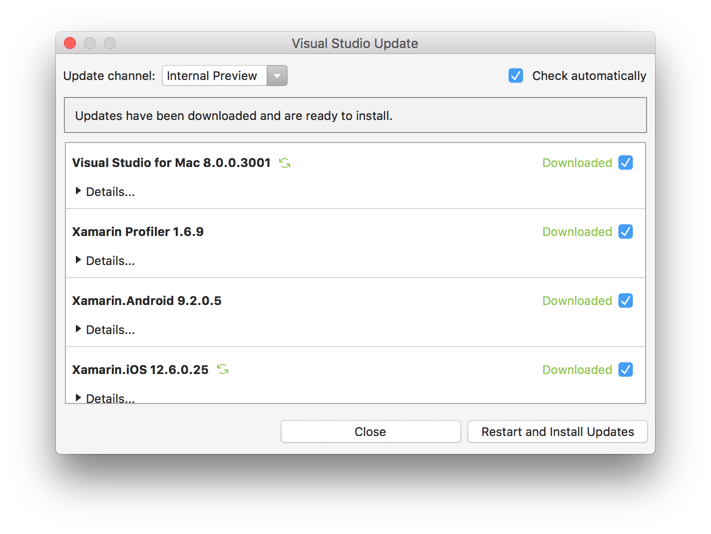
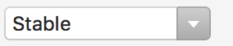
Available today!
Update via the updater
or
install from aka.ms/vsmac
Try the new editor (in preview) and give us feedback via Developer Community

Slide 24
<Q&A>

